Slide 1
MODULE 1: Introduction to Wireless Communication Fundamentals and 5G Technology
M1 S5
Introduction to 5G Technology: Evolution of Cellular Networks: From 1G to 5G

Slide 2
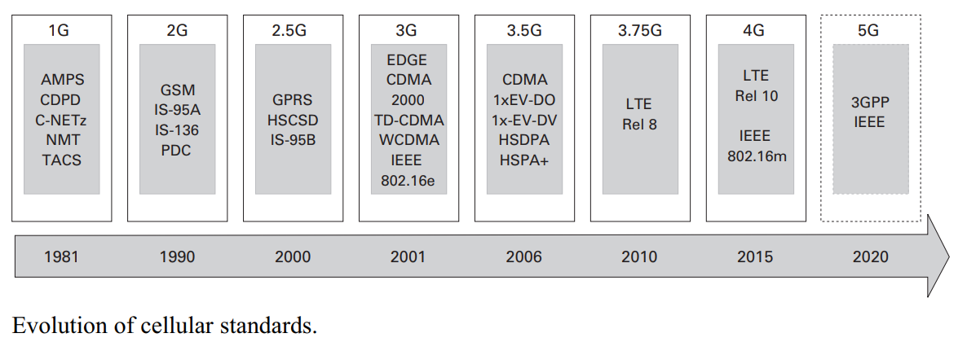
Introduction to 5G Technology: Evolution of Cellular Networks: From 1G to 5G

Slide 3
Introduction to 5G Technology: Evolution of Cellular Networks: From 1G to 5G
Figure illustrates a short chronological history of the cellular radio systems from their infancy in the 1970s (i.e. 1G, the first generation) till the 2020s (i.e. 5G, the fifth generation).
The first commercial analog mobile communication systems were deployed in the 1950s and 1960s, although with low penetration.

Slide 4
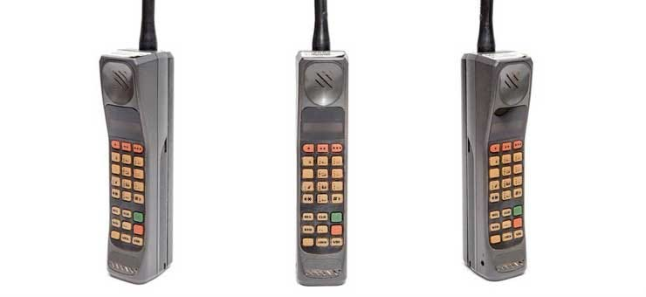
Introduction to 5G Technology: Evolution of Cellular Networks: From 1G to 5G
1G
The year 1981 witnessed the birth of the first commercial deployments of the First Generation (1G) mobile cellular standards such as Nordic Mobile Telephone (NMT) in Nordic countries; C-Netz in Germany, Portugal and South Africa;
Total Access Communications System (TACS) in the United Kingdom; and Advanced Mobile Phone System (AMPS) in the Americas.
The 1G standards are called the analog standards since they utilize analog technology, typically frequency modulated radio signals with a digital signaling channel..

Slide 5
Introduction to 5G Technology: Evolution of Cellular Networks: From 1G to 5G
2G
The European Conference of Postal and Telecommunications Administrations (CEPT) decided in 1982 to develop a pan-European 2G mobile communication system.
This was the starting point of the Global System for Mobile communications (GSM), the dominant 2G standard, which was deployed internationally from 1991.
The introduction of 2G was characterized by the adoption of digital transmission and switching technology.
Digital communication allowed considerable improvements in voice quality and network capacity, and offered growth in the form of supplementary services and advanced applications such as the Short Message Service (SMS) for storage and forwarding of textual information.

Slide 6
Introduction to 5G Technology: Evolution of Cellular Networks: From 1G to 5G
2G
These other main 2G standards include (1) TIA/EIA-136, also known as the North American TDMA (NA-TDMA) std, (2) TIA/EIA IS-95A, also known as CDMAOne (3) Personal Digital Cellular (PDC), used exclusively in Japan.
The evolution of 2G, called 2.5G, introduced packet-switched data services in addition to voice and circuit-switched data.
The main 2.5G standards, General Packet Radio Service (GPRS) and TIA/EIA-951, were extensions of GSM and TIA/EIA IS-95A, respectively.

Slide 7
Introduction to 5G Technology: Evolution of Cellular Networks: From 1G to 5G
2G to 3G
Soon afterwards, GSM was evolved further into the Enhanced Data Rates for Global Evolution (EDGE) and its associated packet data component
Enhanced General Packet Radio Service (EGPRS), mainly by addition of higher order modulation and coding schemes.
GSM/EDGE has continued to evolve and the latest release of the 3GPP standard supports wider bandwidths and carrier aggregation for the air interface.
In parallel, the International
Telecommunications Union, Radio Communications (ITU-R) developed the requirements for systems that would qualify for the International Mobile Telecommunications 2000 (IMT-2000) classification.

Slide 8
Introduction to 5G Technology: Evolution of Cellular Networks: From 1G to 5G
3G
In January 1998, CDMA in two variants – Wideband Code Division Multiple Access (WCDMA) and Time Division CDMA (TD-CDMA) – was adopted by the European Telecommunications Standards Institute (ETSI) as a Universal Mobile Telecommunication System (UMTS).
UMTS was the major 3G mobile communication system and was one of the first cellular systems that qualified for IMT-2000.
Six radio interfaces have been qualified to meet IMT-2000 requirements including three technologies based on CDMA, a version of GSM/EDGE known as UWC-1362 and two technologies based on OFDMA.

Slide 9
Introduction to 5G Technology: Evolution of Cellular Networks: From 1G to 5G
3G to 3.5G & 3.75G
Within the framework of the 3rd Generation Partnership Project (3GPP), new specifications were developed, together known as 3G Evolution as 3.5G.
For this evolution, two Radio Access Network (RAN) approaches and an evolution of the Core Network were suggested.
The first RAN approach was based on the evolution steps in CDMA 2000 within
3GPP2: 1xEV-DO and 1xEV-DV.
The second RAN approach was High Speed Packet Access (HSPA).
HSPA was a combination of High Speed Downlink Packet Access (HSDPA), added in 3GPP Release 5, and High Speed Uplink Packet Access (HSUPA), added in 3GPP Release 6

Slide 10
Introduction to 5G Technology: Evolution of Cellular Networks: From 1G to 5G
3G to 3.5G & 3.75G
Both initially enhanced the packet data rate, to 14.6 Mbps in the downlink and to 5.76 Mbps in the uplink, and quickly evolved to handle higher data rates with the introduction of MIMO.
HSPAwas based on WCDMA and is completely backward compatible with WCDMA.
While CDMA 1xEV-DO started deployment in 2003, HSPA and CDMA 1xEV-DV entered into service in 2006.
All 3GPP standards follow the philosophy of adding new features while still maintaining backward compatibility

Slide 11
Introduction to 5G Technology: Evolution of Cellular Networks: From 1G to 5G
4G
The second UMTS evolution, commercially accepted as 4G, is called Long Term Evolution (LTE) , and is composed of a new air interface based on Orthogonal Frequency Division Multiple Access (OFDMA) and a new architecture and Core Network (CN) called the System Architecture Evolution/Evolved Packet Core (SAE/EPC).
LTE is not backward compatible with UMTS and was developed in anticipation of higher spectrum block allocations than UMTS during World Radio Conference (WRC) 2007.
The standard was also designed to operate with component frequency carriers that are very flexible in arrangement, and supports carriers from 1.4 MHz in width to 20 MHz.

Slide 12
Introduction to 5G Technology: Evolution of Cellular Networks: From 1G to 5G
4G
At the end of 2007, the first LTE specifications were approved in 3GPP as LTE Release 8.
The LTE Release 8 system has peak data rates of approximately 326 Mbps, increased spectral efficiency and significantly shorter latency (down to 20 ms) than previous systems.
Simultaneously, the ITUR was developing the requirements for IMT-Advanced, a successor to IMT-2000, and nominally the definition of the fourth generation.
LTE is uniformly accepted as 4G, 3GPP LTE Release 10 and IEEE 802.16 m (deployed as WiMAX) were technically the first air interfaces developed to fulfill IMT-Advanced requirements. Despite being an approved 4G technology, WiMAX has had difficulties in gaining widespread acceptance and is being supplanted by LTE.

Slide 13
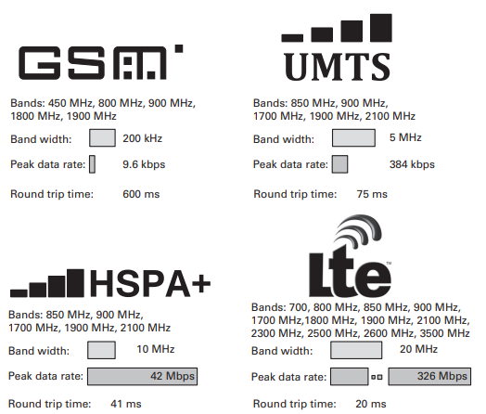
Introduction to 5G Technology: Evolution of Cellular Networks: From 1G to 5G

Slide 14
!!THANK YOU!! !! Have a Nice Day!!
Today we learned about
Introduction to 5G Technology: Evolution of Cellular Networks: From 1G to 5G

Slide 15
MODULE 1: Introduction to Wireless Communication Fundamentals and 5G Technology
M1 S6
Key Features and Objectives of 5G

Slide 16
Key Features and Objectives of 5G
Let's take a closer look at some of the features and benefits of 5G for businesses.
Point-1
The most-discussed 5G feature is increased speed and bandwidth.
With a data rate of up to 10 Gbps, 5G will bring a 10 times to 100 times improvement over the existing 4G LTE technology. Cellular is now a potential technology for branch office automation because WAN connections finally have enough bandwidth.
For businesses, the real benefit of 5G might not be the actual bandwidth, but the pressure that 5G exerts on market prices of incumbent WAN connectivity.

Slide 17
Key Features and Objectives of 5G
Point-2
5G's low latency, under 5 milliseconds, is the other key benefit for WAN usage.
Customers are using MPLS or dedicated lines today primarily for low latency in line-of-business applications.
5G's low latency may bring additional flexibility that lets businesses jettison some of their branch office MPLS infrastructure in favor of the less expensive and more flexible 5G connections to branches.
This is especially true in retail or shared infrastructure or very remote environments..

Slide 18
Key Features and Objectives of 5G
Point-3
5G density enables up to 100 times more connected devices in the same physical area that 4G LTE operates today, while maintaining 99.999% availability.
While this density may bring business advantages for mobile workforces, the real benefit is increasing the size of the mobile customer market.
Mobile e-commerce is growing faster than retail and traditional computer-based e-commerce.
More customers than ever use mobile technologies to shop online, so greater density increases the overall addressable market...

Slide 19
Key Features and Objectives of 5G
Point-4
An estimated 90% reduction in power consumption for devices means minor power savings at the smartphone level.
But, from an infrastructure perspective, especially for IoT devices, the power savings could be significant.
Combining IoT devices with a cellular 5G communication means lower power overhead in design and actual consumption.
Remote devices can be expected to last significantly longer when running on battery alone.
Some estimates even show that a 10-year remote battery life may be achievable for IoT-based sensor devices deployed in remote locations....

Slide 20
Key Features and Objectives of 5G
Point-5
Security is always a concern for mobile devices and IoT devices because the latter live on the edge of the corporate network.
With 5G, stronger security than 4G LTE is available for designers, including hardware security modules, key management services, over the air, secure element and others.
This will help ensure that the data transmitted over the 5G network is secure while also hardening network endpoints.....

Slide 21
Key Features and Objectives of 5G
Objective
The 5G-SOLUTIONS main project objective is to conduct advanced field trials of innovative and thematically diverse digital services that require 5G capabilities and performance in the vertical domains of Factories of the Future, Smart Energy, Smart Cities, Smart Ports and Media & Entertainment, directly engaging with end-user actors, so as to validate the technological performance of 5G technology in successfully serving them, as well as validate the business models and potential of these use cases prior to commercial deployment.
The main project’s aim will be realized through 6 key interdisciplinary objectives, as listed in next slide

Slide 22
Key Features and Objectives of 5G
Objective 1: Innovation with vertical industry expert users:
To develop realistic, advanced and business relevant innovative use case scenarios in five key vertical industries.
Objective 2: Technology development and readiness:
To interface with key ICT-17 facilities and develop the technological enablers for the validation of the use cases.
Objective 3: Technological validation:
To demonstrate the potential and the user value of advanced 5G solutions through extensive technological validation in field trials directly involving end-users in Living Labs (LLs).

Slide 23
Key Features and Objectives of 5G
Objective 4: Business validation and innovation:
To develop and validate the business models of the use cases in 5G-SOLUTIONS LLs, whilst ensuring long-term social acceptance and economic sustainability, extending beyond the lifespan of the project through a joint commercialization plan..
Objective 5: Contribution to standardization, open source and communities:
To provide significant contribution to relevant 5G standardization bodies, to relevant open source communities, to relevant industry standardization and user/technology communities.
Objective 6: Dissemination and outreach:
To disseminate and exploit the project’s results, to maximize the project's visibility and facilitate dissemination and communication activities, and to contribute to the objectives of the European 5G-PPP Programme.

Slide 24
5G Applications and use cases
This next-generation technology will benefit societies and machines in various ways. There are several 5G use cases and 5G applications that can restructure the entire world. The 5G uses range from device communication to business support.
Enhanced mobile services with broadband-like connectivity
Using the Internet of Things (IoT) to its optimum capabilities
Better business management | High-quality streaming and gaming
More accurate information regarding location tracking
Production of autonomous vehicles
Revolutionizing the entertainment and education industries
Waste management and water treatment
Smart cities infrastructure

Slide 25
!!THANK YOU!! !! Have a Nice Day!!
Today we learned about
Key Features and Objectives of 5G

Slide 26
MODULE 1: Introduction to Wireless Communication Fundamentals and 5G Technology
M1 S7
5G use cases

Slide 27
5G use cases
THIS TOPIC WE WILL LEARN BY DOING GROUP ACTIVITY
Divide the Class into (No. of students / 5) Groups
Assign 1 Topic of Case study to each group (From the Following)
Group has to prepare the topic in 20min for 5min presentation with chalk-board
Sr. No. | Case Study Topic
1 | Smart cities
2 | Autonomous vehicles
3 | Improved viewing experience at sporting events
4 | 5G drones
5 | Immersive entertainment
5G use cases: 31 examples that showcase what 5G is capable of | 5Gradar

Slide 28
!!THANK YOU!! !! Have a Nice Day!!
Today we learned about
5G use cases

Slide 29
MODULE 1: Introduction to Wireless Communication Fundamentals and 5G Technology
M1 S8
5G use cases

Slide 30
5G use cases
THIS TOPIC WE WILL LEARN BY DOING GROUP ACTIVITY
Divide the Class into (No. of students / 5) Groups
Assign 1 Topic of Case study to each group (From the Following)
Group has to prepare the topic in 20min for 5min presentation with chalk-board
Sr. No. | Case Study Topic
1 | Over ground trains going underground
2 | Connected cows and calving
3 | Healthcare
4 | Construction & Energy preservation
5 | IP broadcasting
5G use cases: 31 examples that showcase what 5G is capable of | 5Gradar

Slide 31
!!THANK YOU!! !! Have a Nice Day!!
Today we learned about
5G use cases

Slide 32
MODULE 1: Introduction to Wireless Communication Fundamentals and 5G Technology
M1 S9
Key Features and Objectives of 5G

Slide 33
Challenges and Opportunities in 5G Deployment
5G-New Radio (NR) Deployment Challenges Due to the Coverage
5G Band selection:
Wideband spectrum availability vs. coverage.
The availability of the bands below 3 GHz remains limited for 5G- New Radio in the near future and the lower bands fail to support high data rates due to their limited bandwidth.
On the other hand, the wider NR bands above 3 GHz experience increased propagation losses, leading to a limited coverage.
Therefore, independent usage of the spectrum below and above 3 GHz fails to strike a compelling trade-off between a high data rate and large coverage

Slide 34
Challenges and Opportunities in 5G Deployment
5G-New Radio (NR) Deployment Challenges Due to the Coverage
DL/UL ratio:
Spectrum utilization effciency vs. DL/UL coverage balance vs. multi-service operation:
The NR TDD operation is usually configured for a limited number of UL transmission slots (e.g., DL:UL = 4:1) in a frame due to the heavy DL traffc load, even though more slots should be allocated to the UL for improving the UL coverage.
This can increase the UL data rates, when the bandwidth can not be further increased due to the maximum transmission power constraint.
massive machine-type communication (mMTC),
ultrareliable and low-latency communication (URLLC).
enhanced mobile broadband (eMBB),

Slide 35
Challenges and Opportunities in 5G Deployment
5G-New Radio (NR) Deployment Challenges Due to the Coverage
DL/UL ratio:
Spectrum utilization efficiency vs. DL/UL coverage balance vs. multi-service operation:
Since the DL spectral efficiency is usually higher than that of the UL, having more UL slots would, then, further reduce the spectral utilization efficiency.
Therefore, there is a clear trade-off between the UL coverage and spectral utilization efficiency.

Slide 36
Challenges and Opportunities in 5G Deployment
5G-New Radio (NR) Deployment Challenges Due to the Coverage
DL/UL ratio:
Spectrum utilization efficiency vs. DL/UL coverage balance vs. multi-service operation:
In addition, 5G system is required to provide diverse services
It is hard for a single-network TDD configuration to fit to multiple type of services.
Efficient transmission requires high DL resource proportion, while IoT services for low power wide-area scenario (LPWA) are highly dependent on the UL coverage and thus need continuous UL transmission and preferably as low path loss as possible.
Therefore, efficient 5G spectrum exploitation mechanism is desired to support all kinds of services using a unified TDD configuration..

Slide 37
Challenges and Opportunities in 5G Deployment
5G-New Radio (NR) Deployment Challenges Due to the Coverage
TDD DL/UL switching period:
Transmission efficiency vs. latency.
For the TDD operation, frequent DL/UL switching is required for cellular services to provide very quick DL/UL scheduling and almost immediate ACK/NACK feedback.
However, a certain guard period is also needed at each DL/UL switching point (e.g., 130μs is used in TD-LTE networks) for avoiding serious blocking of the UL receiver due to the strong DL interference emanating from other cells..

Slide 38
Challenges and Opportunities in 5G Deployment
5G-New Radio (NR) Deployment Challenges Due to the Coverage
TDD DL/UL switching period:
Transmission efficiency vs. latency.
Frequent DL/UL switching would lead to a high idle time (14.3% vs. 2.8% for 1 ms and 5 ms switch period).
Such a short DL/UL switching period in a single TDD band network operation will lead to an unacceptable degradation of spectrum efficiency for eMBB transmission, which is generally in favor of a larger DL/UL switching period, e.g., 2.5 ms or 5 ms..

Slide 39
Challenges and Opportunities in 5G Deployment
5G-New Radio (NR) Deployment Challenges Due to the Coverage
Site planning:
seamless coverage vs. deployment investment and mobility:
For early 5G-NR deployment, co-site installation with the existing LTE networks would be cost effective and convenient.
However, due to the higher propagation loss above 3 GHz, one has to introduce denser cells and new sites.
Otherwise, 5G-NR cannot attain the same seamless UL coverage as that of LTE.

Slide 40
Challenges and Opportunities in 5G Deployment
5G-New Radio (NR) Deployment Challenges Due to the Coverage
Site planning:
seamless coverage vs. deployment investment and mobility:
In summary, for a fast and cost-effective 5G network deployment, to accommodate multi-services of both eMBB and IoT applications effciently, and to balance the spectrum effciency, coverage, as well as low latency, 5G network has to operate on both high-frequency wideband TDD band for high capacity and low-frequency band with good coverage.

Slide 41
!!THANK YOU!! !! Have a Nice Day!!
Today we learned about
Challenges and Opportunities in 5G Deployment

